Slide 1
CAPSTONE PROJECT
SENTIMENT ANALYSIS
Presented By :
1. Student Name : Desamsetty Satya Sree Anjana
2.College Name : Aditya College of Engineering,Surampalem
3.Department : Electronics and Communication Engineering(ECE)

Slide 2
OUTLINE
Problem Statement (Should not include solution)
Proposed System/Solution
System Development Approach (Technology Used)
Algorithm & Deployment
Result
Conclusion
Future Scope
References

Slide 3
PROBLEM STATEMENT
Develop a sentiment analysis model to classify reviews as positive or negative.
Preprocess the review text using techniques such as lowercasing , removing stop words and lemmatization

Slide 4
PROPOSED SOLUTION
The proposed system aims to analyze the comments/reviews given by the customers and increase the effectiveness of the companies . It helps in customer feedback analysis , product reputation management , product development and innovation etc…. . The solution will consist of the following components:
Data Collection:
Collect the data regarding the restaurant reviews containing columns such as reviews and liked.
Utilize the Online platforms related to the restaurants to collect the restaurant reviews dataset.
Data Preprocessing:
Clean and preprocess the collected data to handle missing values, outliers, and inconsistencies.
This involves several steps including removing the punctuations , lowercasing the text , tokenization , stemming , lemmatizing words , removing the stop words , removing the numbers , normalization and removing html tags.
Machine Learning Algorithm:
After the data is preprocessed and features are extracted , we use Machine Learning(ML) algorithm to make predictions or decisions based on the data
The ML algorithm NAÏVE BAYES is used as it works well with categorial data using Bayes Theorem with strong independent assumptions .
Deployment:
Deploy the solution on a scalable and reliable platform, considering factors like server infrastructure, response time, and user accessibility.
Evaluation:
Assess the model's performance using appropriate metrics such as Accuracy , Precision , Recall , Support , Macro , Weighted Averages or other relevant metrics.
Fine-tuned the model based on feedback and continuous monitoring of prediction accuracy.
Result: The accuracy of the dataset used in the algorithm is 0.8

Slide 5
SYSTEM APPROACH
This section outlines the overall strategy and methodology for developing and implementing the AI and ML project on Sentiment Analysis.
System requirements
Hardware Requirements:
Core i5/i7 processor
At least 8 GB RAM
Software Requirements:
Python 3.x
Anaconda Distribution
NLTK Toolkit
UNIX/LINUX Operating System.
Library required to build the model
pandas
nltk
seaborn and matplotlib
sklearn

Slide 6
ALGORITHM & DEPLOYMENT
In the Algorithm section, the machine learning algorithm chosen for sentiment analysis is Naïve Bayes. The structure for the section is as follows:
Algorithm Selection:
The Naïve Bayes algorithm is used because of it’s probabilistic approach that makes predictions based on evidence and prior probabilities. It is often used in text classification tasks because it is simple and efficient.
It makes the assumption that the presence of a particular feature in a class is unrelated to the presence of other features in that class. This assumption is called class-conditional independence.
Data Input:
The dataset consists of reviews and likes column . Before using the reviews for training, it’s essential to preprocess them to remove noise and standardize the text . Some of the preprocessing steps are convert to lower case , remove punctuation , tokenization etc..
Training Process:
The main chunk of code that does the whole evaluation of sentimental analysis based on the preprocessed data is a part of training.
The Navie Bayes are applied on the dataset for evaluation of sentiments.
Prediction Process:
Prediction of test data is done and Confusion Matrix of prediction is displayed. Total positive and negative reviews are counted
A review like sentence is taken as input on the console and if positive the console gives 1 as output and 0 for negative input.

Slide 7
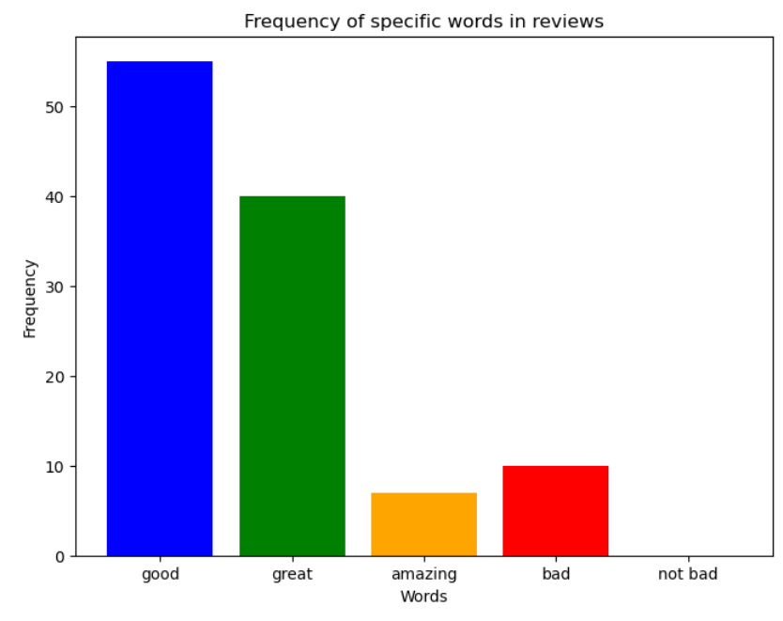
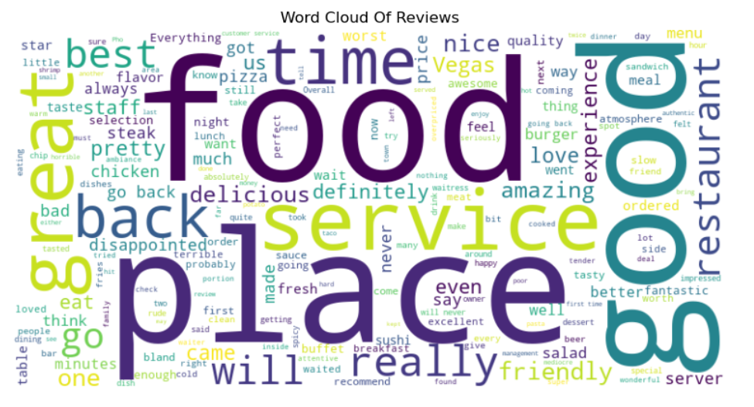
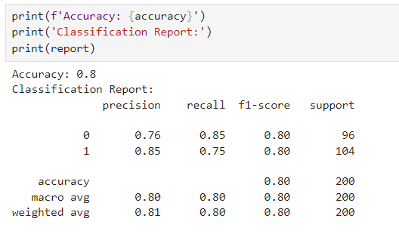
RESULT
The above bar graphs shows the numbers of times the specific words are used in the reviews
The image indicates that the words such as food , place ,good are used in high frequency in the reviews given by customers .
Results of the testing after Model Training .The accuracy was 80%.which depicts the performance of the model based on metrics in the figure .

Slide 8
CONCLUSION
Sentiment analysis is not just about words; it’s about understanding people, their desires, and their pain points. It’s about gaining a deeper understanding of your audience and building meaningful connections .
Challenges:
The sentiment analysis tools are primarily trained to categorize the words in one language, and some sentiments may get lost in translation. This causes a significant problem, especially while conducting sentiment analysis on non-English reviews or feedback.
Importance:
Sentiment analysis enables companies with vast troves of unstructured data to analyze and extract meaningful insights from it quickly and efficiently. With the amount of text generated by customers across digital channels, it’s easy for human teams to get overwhelmed with information.

Slide 9
FUTURE SCOPE
With increase in the customers , there is a need to improve the technology to provide better service and to increase the brand image.
The potential enhancement for the system is the convergence of sentiment analysis with other AI pillars like image and voice recognition.
The future of sentiment analysis converges with the trajectory of NLP technologies. Innovations in NLP amplify sentiment analysis capabilities.
Model GPT-3 helps with increase in the capacity for language generation and understanding reaches new heights .
Algorithm optimization by using advanced embeddings BERT.
Scale the system to cover multiple cities or regions for wider applicability

Slide 10
REFERENCES
Online Sources :
Google
Chatgpt
Github : https://github.com/Naviden/Sentiment-Analysis-in-Python
Geeksforgeeks : https://www.geeksforgeeks.org/what-is-sentiment- analysis/
IBM Website : https://www.ibm.com/topics/sentiment-analysis
Articles : https://www.ibm.com/topics/artificial-intelligence
edureka
McCallum, A., & Nigam, K. (1998). A comparison of event models for Naive Bayes text classification. In AAAI-98 Workshop on Learning for Text Categorization (pp. 41-48).

Slide 11

THANK YOU

